Slide 1
Convolutional Neural Networks in Autonomous Driving
By
Sepehr Nematollahi
Supervisors
Dr. Mamen Carmen Romano
Dr. Francisco Perez-Reche

Slide 2
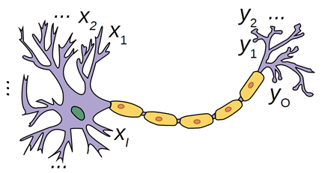
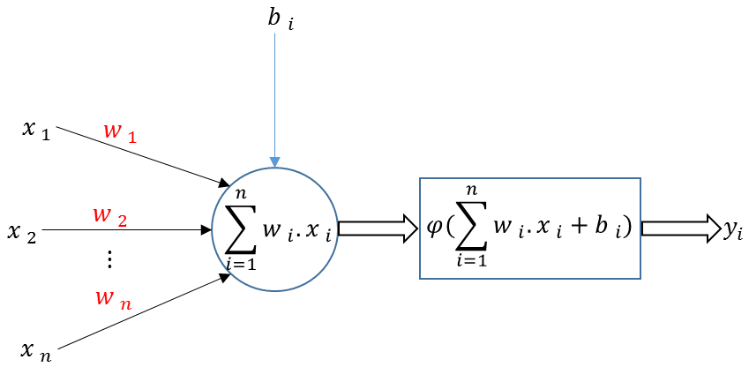
Introduction
Neuron in Human Brain
Neuron in Artificial Intelligence
Activation Function

Slide 3

Methodology
Training Neural Networks
Backpropagation
Optimization
Loss
Value
$$w$$
Training Data
{Input, Correct Output}
Input
Output
Loss
Function
Correct Output

Slide 4
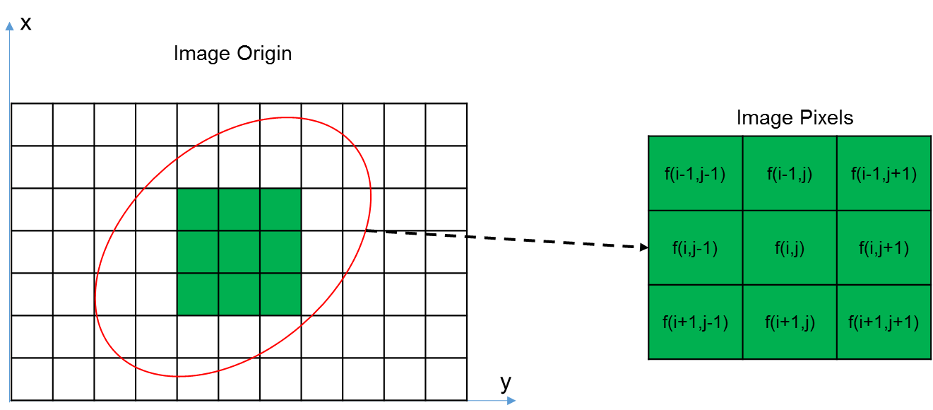
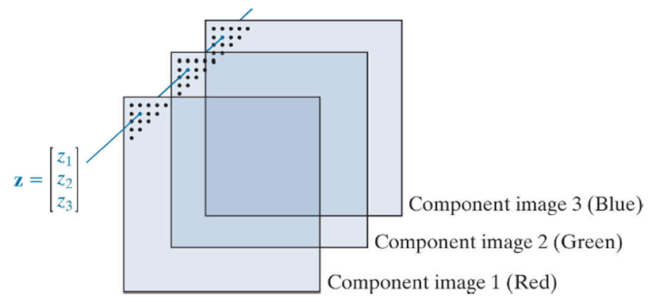

Image Processing
Digital Image (Grey Scale)
$f(x,y)$
RGB Color Channels

Slide 5
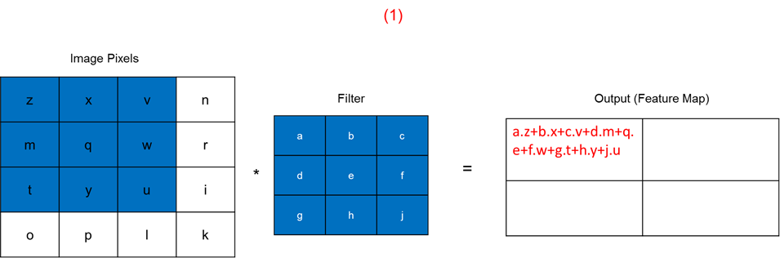
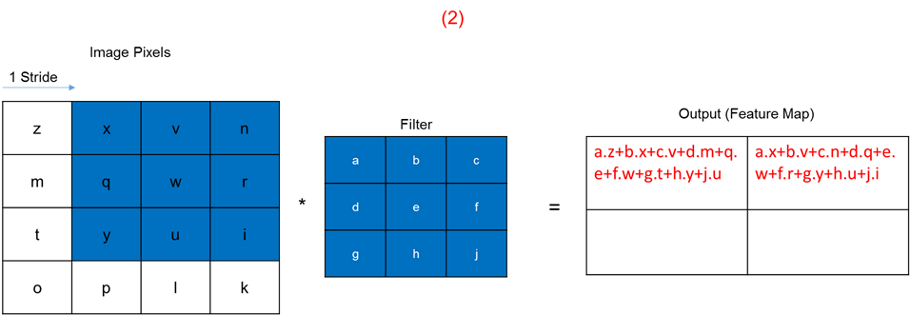
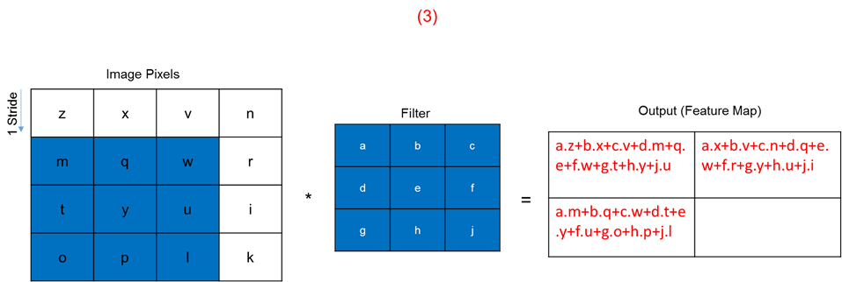
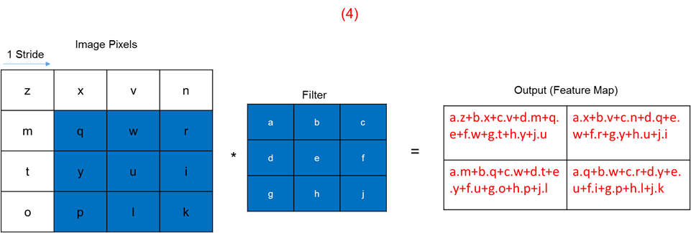

Methodology
Convolution:
$$S(i, j) = (f ∗ w)(i, j) =\sum_{m}{\sum_{n}{w\left(m, n\right)f\left(i − m, j − n\right) }}$$

Slide 6
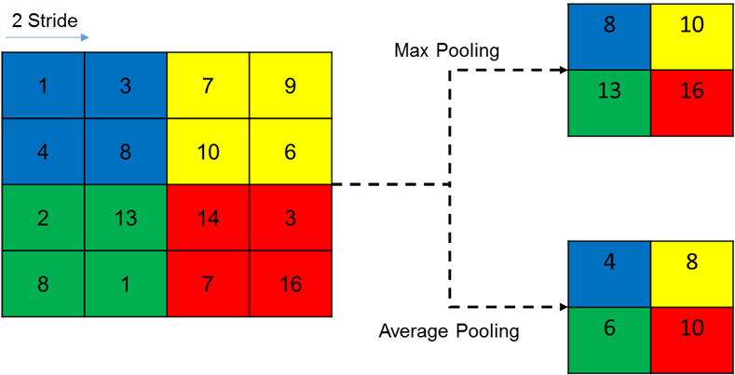



Methodology
Convolutional Neural Networks:
Image Classification
Semantic Segmentation
Object Detection
$$bias$$
Input
Output (Feature Maps)
Activation Function
Conv2d
ReLU
Pooling
$$h x w x d$$
$$h^{′} x w^{′}x{ d}^{′}$$

Slide 7
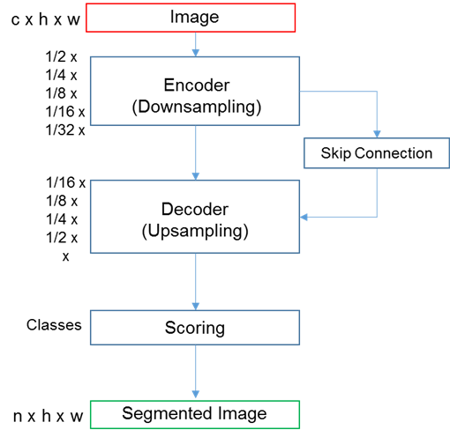
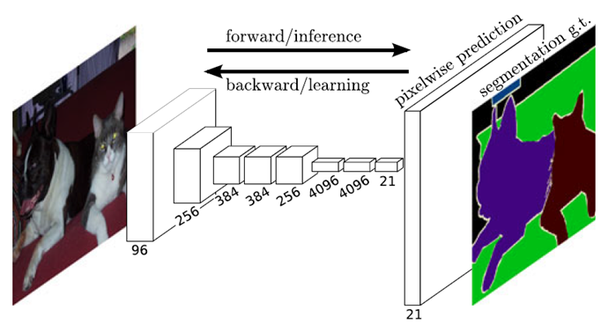
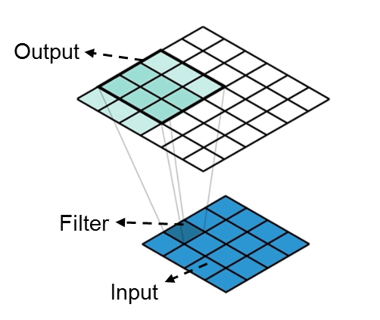
Methodology
Fully Convolutional Network for Semantic Segmentation (Long et al,2015)
FCN-32s
FCN-16s
FCN-8s

Slide 8

Analysis of the Network Architectures
CamVid Dataset
Setting
Epoch=55
Loss Function:
$$L=\sum_{i=1}^{M}{\{d_{i}.\log\left(y_{i}\right)}+\left(1−d_{i}\right).log⁡(1−y_{i})\}$$
Optimization Function:
$$d_{t}=β d_{t−1}+\left(1−β\right){\left[\frac{∂L}{∂w_{t}}\right]}^{2}$$
$$M_{t} = momentum ∗ M_{t−1}−\frac{α}{\sqrt{d_{t}−ε}}.\frac{∂L}{∂w_{t}}$$
$$w_{t+1}=w_{t}−M_{t}$$

Slide 9
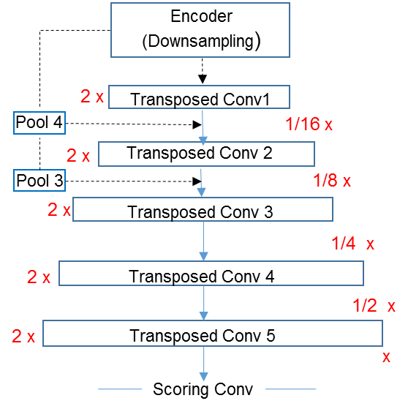
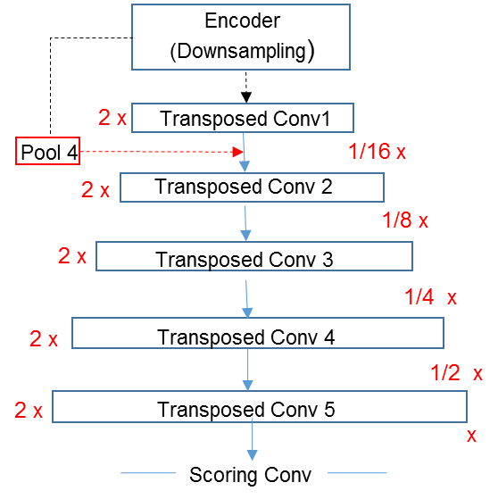
Architecture 0 and Modified Version
Arch 0
Arch 0.1

Slide 10
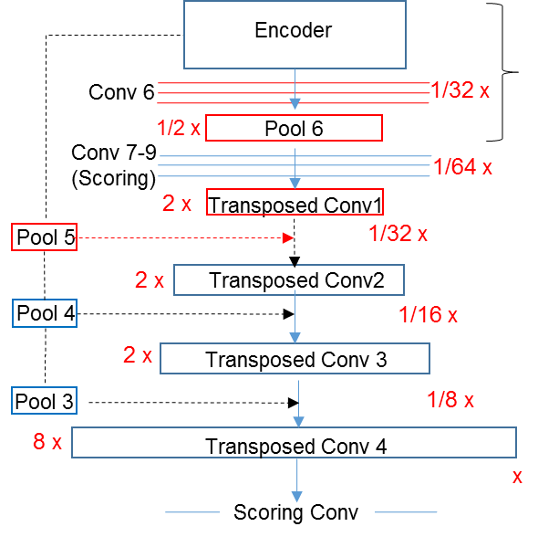
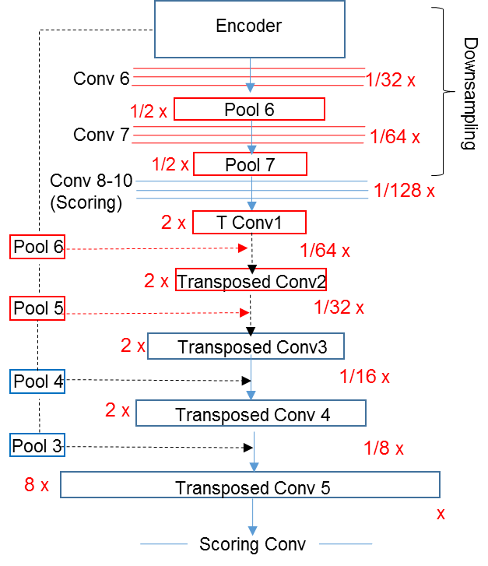
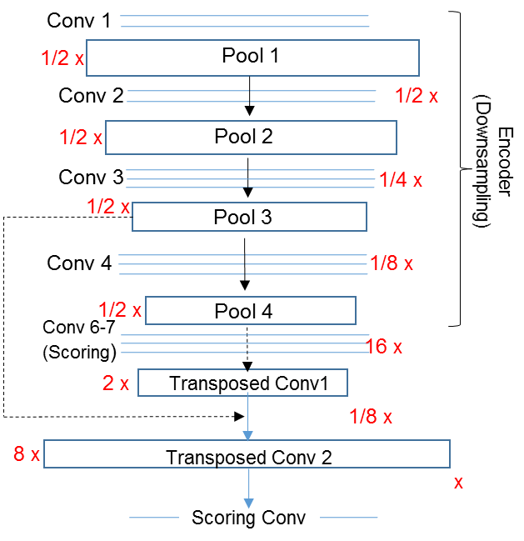
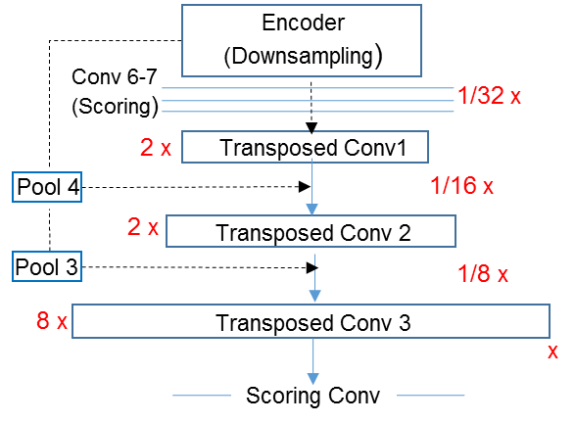
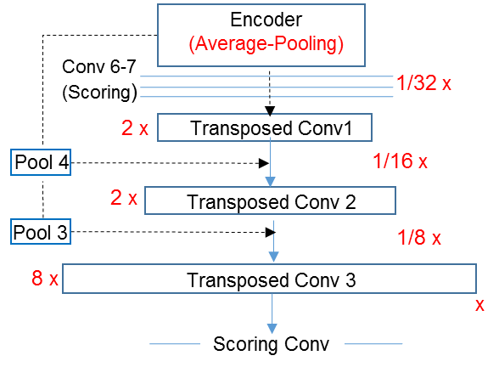
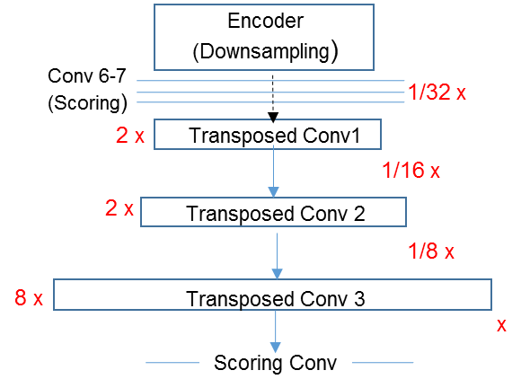
Architecture 1 and Modified Versions
Arch 1.1
Arch 1.2
Arch 1.3
Arch 1.4
Arch 1
Arch 1.5

Slide 11
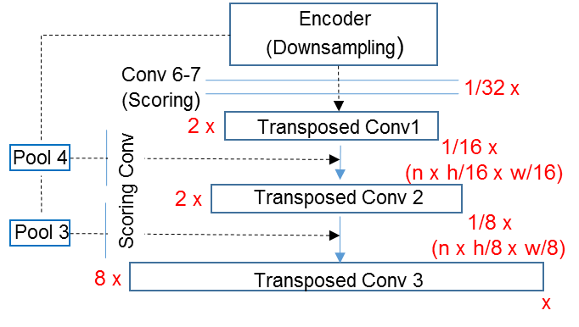
Architecture 2
Arch 2

Slide 12
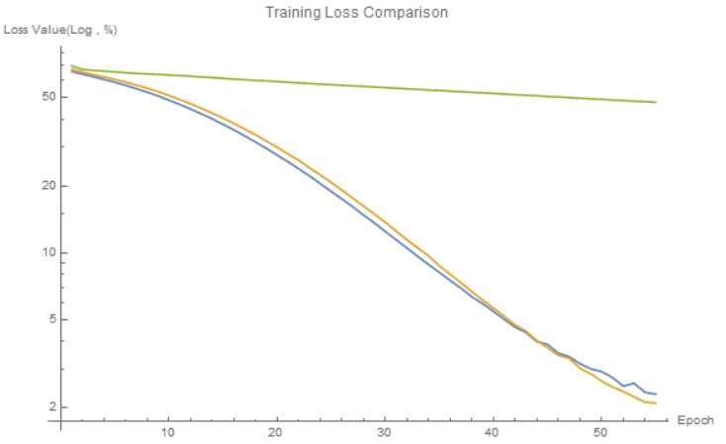
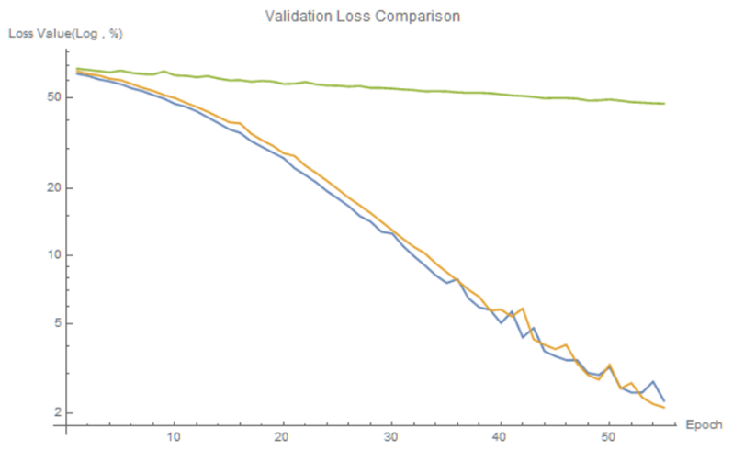

Result & Discussion
Training/Validation Main Architecture
FCN | Training Loss% | Validation Loss% | Mean IOU%
Architecture 0 | 2.31 | 2.27 | 25.6
Architecture1 | 2.10 | 2.13 | 33.3
Architecture2 | 47.7 | 47.4 | 16.9

Slide 13
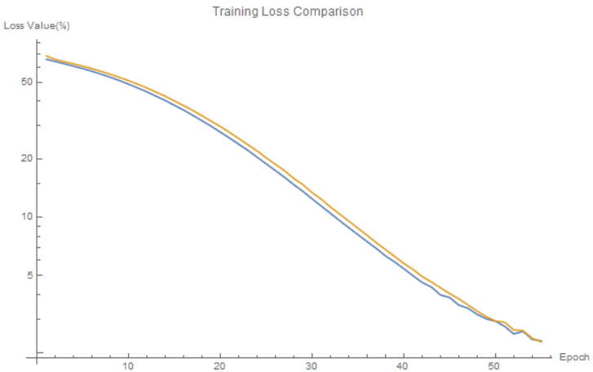
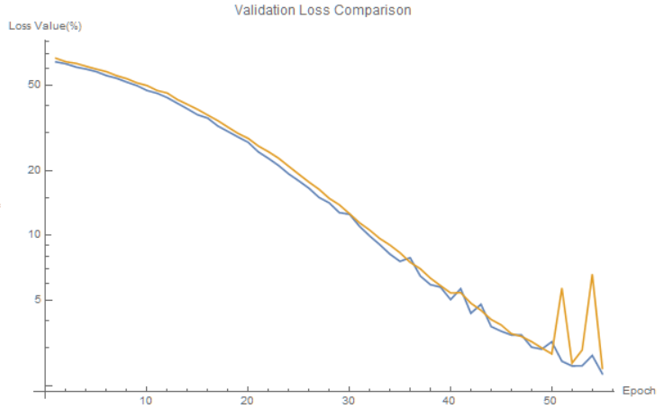
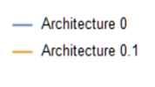

Result & Discussion
Training/Validation Loss Architecture 0 and Modified Version
FCN | Training Loss% | Validation Loss% | Mean IOU%
Architecture 0 | 2.31 | 2.27 | 25.6
Architecture 0.1 | 2.28 | 2.42 | 28.2

Slide 14
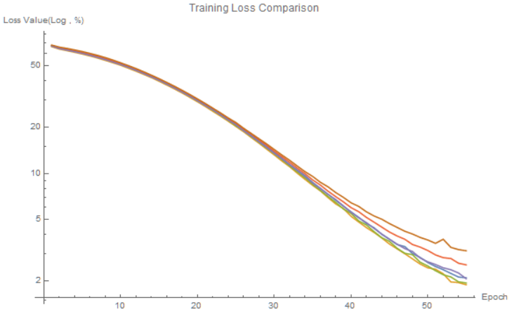
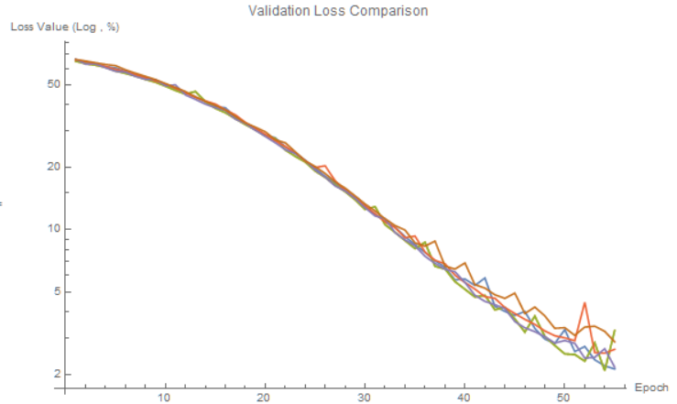
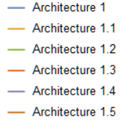
Result & Discussion
Training /Validation Loss of Architecture 1 and Modified Versions
FCN | Training Loss% | Validation Loss%
Architecture1 | 2.10 | 2.13
Architecture1.1 | 1.89 | 3.26
Architecture1.2 | 1.94 | 2.36
Architecture1.3 | 2.54 | 2.64
Architecture1.4 | 2.07 | 2.17
Architecture1.5 | 3.14 | 2.87

Slide 15
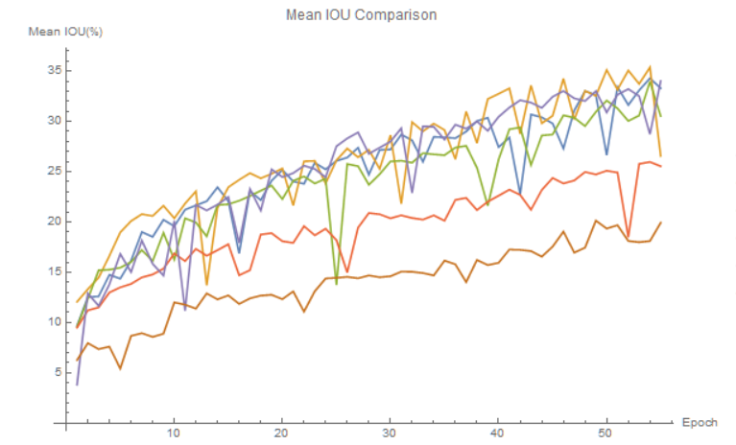
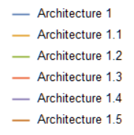
Result & Discussion
Mean IOU of Architecture 1 and Modified Versions
FCN | Mean IOU%
Architecture1 | 33.3
Architecture1.1 | 26.5
Architecture1.2 | 30.5
Architecture1.3 | 25.5
Architecture1.4 | 34.0
Architecture1.5 | 19.9

Slide 16
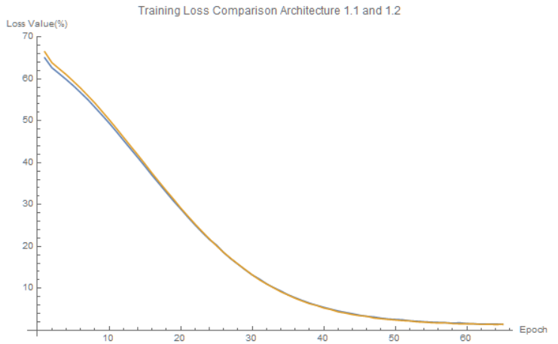
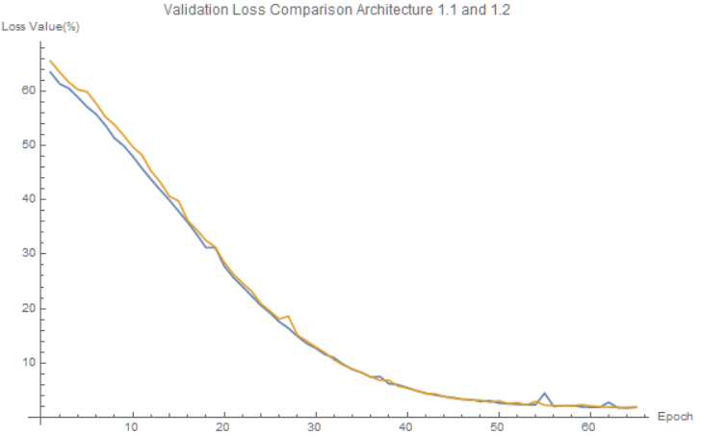

Result & Discussion
Training/ Validation Loss of Architecture 1.1 and 1.2 (Epoch=65)

Slide 17
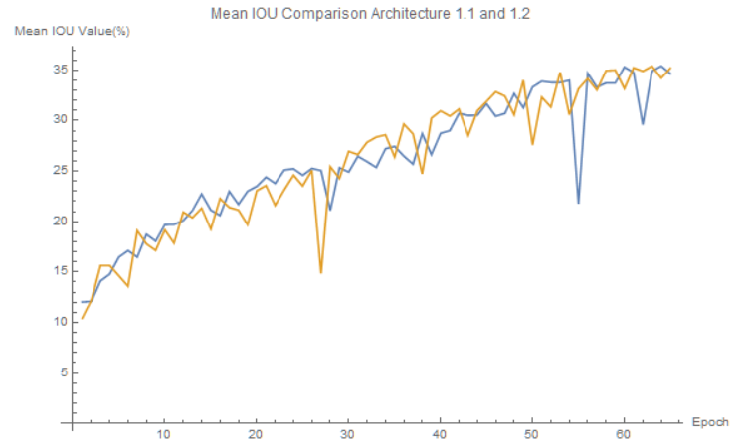
Result & Discussion
Mean IOU of Architecture 1.1 and 1.2 (Epoch=65)

Slide 18
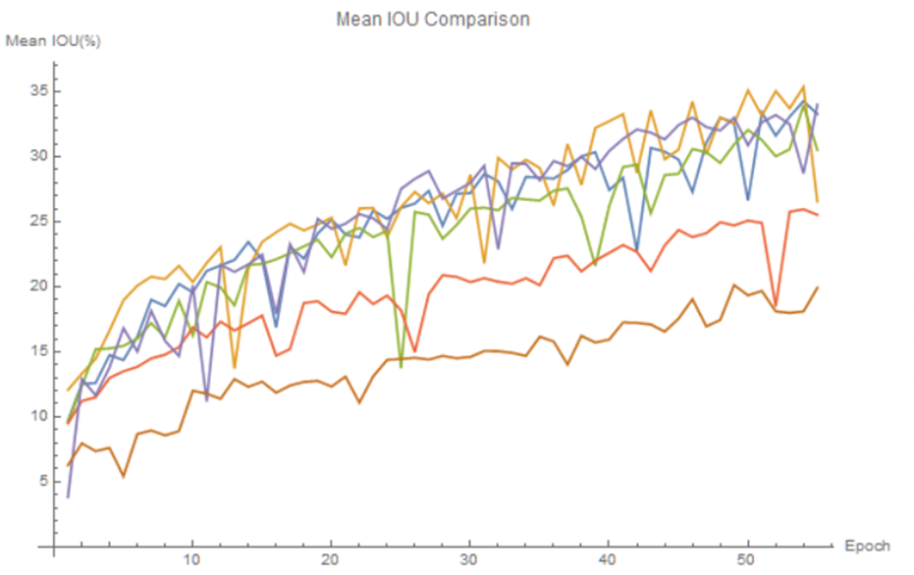

Conclusion
Main Operation
Semantic Segmentation for the Purpose of Self Driving Car
Wrap up
FCN and Modified Versions
Oscillations
Main Result
Skip connection
Convolution Block

Slide 19
Thank You!
Gracias!
Obrigado!
متشکرم!

Slide 20
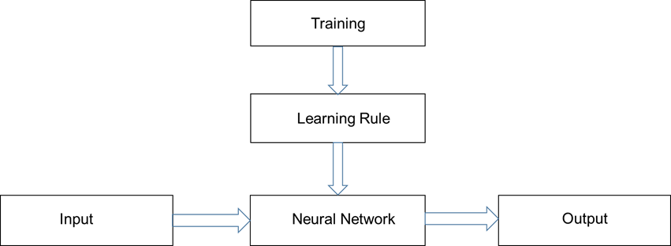
Neural Network

Slide 21
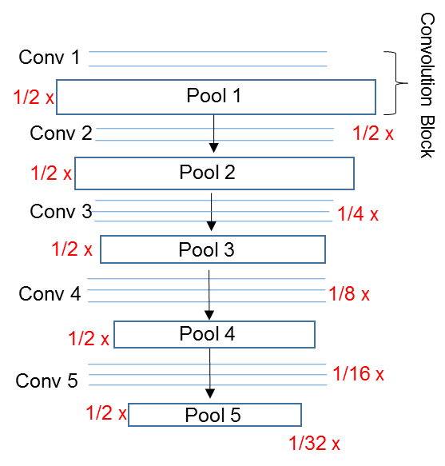
Downsampling Block

Slide 22
Comparison to the Original Research
The orange section belongs to Long et al accuracy parameters and the green part belongs to our work, so we regard them with the colors.
Architecture | FCN-8s | FCN-16s | FCN-32s | Acrh 1 (FCN-8s) | Arch 1.1 | Arch 1.2 | Arch 1.3 | Arch 1.4 | Arch1.5 (FCN-32s)
Pixel Accuracy(%) | 71.8 | 71.8 | 69.8 | 90.8 | 85.1 | 89.4 | 88.4 | 90.7 | 86
Mean IOU(%) | 53.5 | 53.4 | 50.4 | 33.3 | 26.5 | 30.5 | 25.5 | 34 | 19.9

Slide 23
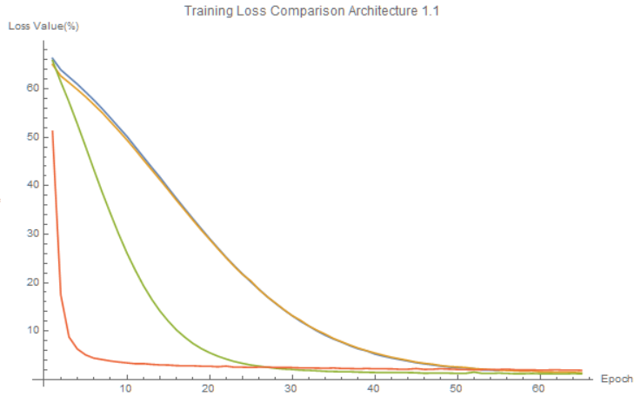
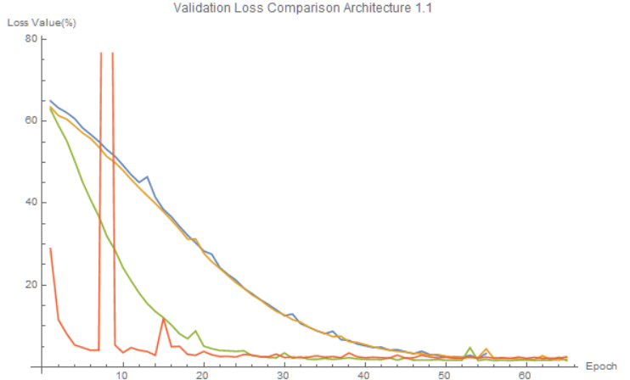
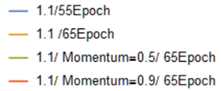
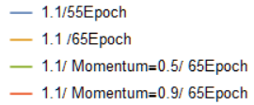
Result & Discussion
Training/Validation Loss Architecture 1.1 (Epoch=55,65 & Momentum=0.5,0.9)

Slide 24
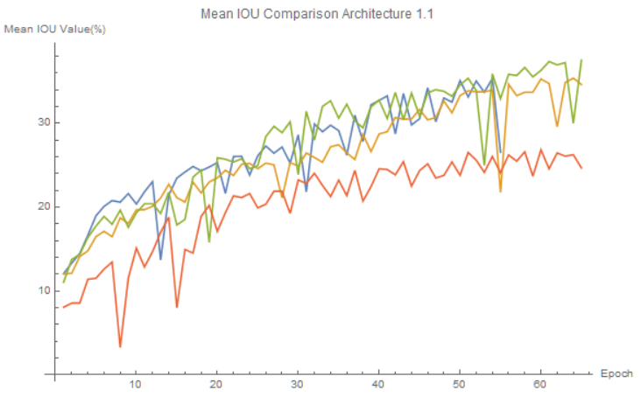
Result & Discussion
Mean IOU Architecture 1.1 (Epoch=65,55 & Momentum=0.5,0.9)

Slide 25

Gradient Decent
$y_{i}=φ(v_{i})$
$L_{i}=−\frac{1}{2} {(d_{i}−y_{i })}^{2}$
$\frac{∂L}{∂w_{i}}=\frac{∂L}{∂y_{i}} \frac{∂y_{i}}{{∂w}_{i}}=−\frac{1}{2} 2(d_{i}−y_{i })\frac{∂φ}{{∂w}_{i}}$
$w_{t+1}=w_{t}−α\frac{∂L}{∂w}$

